Slide 1

Department of Computer Science and Engineering
Title of the Project
PRESENTED BY
Name of the Student T.Bhuvanesh (Roll No.) 21471A05K4
Name of the Student K.Vinay (Roll No.) 21471A05H4
Name of the Student Dondapati Tharun Kumar (Roll No.) 21471A05E8
Under the Guidance of,
Dr.S.N.Tirumala Rao_{Qualification},
Prof & Head, Dept of CSE,
Department of Computer Science and Engineering,
Narasaraopeta Engineering College (Autonomous),
Narasaraopet- 522 601.

Slide 2
OUTLINE
Abstract
Introduction
Literature Survey
Research Gaps
Problem Statement
Objectives
Block Diagram / Flow Diagram
Methodology
Implementation
Results and Analysis
Conclusion & Future Scope
References
Question and Answers
Acknowledgements

Slide 3
ABSTRACT
Ensuring helmet compliance is a critical factor in improving safety across construction sites and roadways. Despite the mandatory nature of helmet usage, many individuals neglect it due to discomfort or low awareness. This study introduces a dual-purpose automated detection system leveraging YOLOv8 for real-time helmet detection in construction sites and motorcycle monitoring. The system identifies helmet usage, captures license plate information, and organizes data, including timestamps, in Excel sheets. By addressing limitations of traditional approaches like manual monitoring and less accurate algorithms, this method offers significant improvements in speed, precision, and reliability. Its application ensures enhanced safety enforcement with minimal manual oversight, paving the way for safer environments and efficient management systems.

Slide 4
INTRODUCTION
Brief Introduction to the Project
The project focuses on creating a robust, automated system for detecting workers without helmets in construction sites. Utilizing advanced computer vision techniques, specifically the YOLOv8 model, the system aims to ensure safety compliance in real-time. The integration of license plate recognition adds accountability and enhances monitoring.
Motivation Behind the Project
Non-compliance with helmet usage remains a critical issue in high-risk environments, leading to severe injuries and fatalities. Manual inspection methods are inefficient, time-consuming, and prone to errors. This project is driven by the need for a scalable and reliable solution to enforce safety measures effectively and reduce risks to workers' lives.

Slide 5
INTRODUCTION
Importance and Relevance
The system addresses a vital safety concern, aligning with global safety standards in construction and industrial domains. By automating helmet detection, it minimizes human errors, reduces inspection delays, and ensures regulatory compliance. The project contributes to safer work environments and highlights the role of AI in enhancing workplace safety.

Slide 6
LITERATURE SURVEY
No | Title | Author | Journal Name & Year | Methodology Adapted | Key Findings | Gaps
1 | A Smart System for Personal Protective Equipment Detection in Industrial Environments Based on Deep Learning at the Edge | G. Gallo, F. D. Rienzo, F. Garzelli, P. Ducange, C. Vallati https://www.researchgate.net/publication/365108908_A_Smart_System_for_Personal_Protective_Equipment_Detection_in_Industrial_Environments_Based_on_Deep_Learning_at_the_Edge | IEEE Access, 2022 | Deep Learning at the Edge, Personal Protective Equipment (PPE) detection | A deep learning-based system for PPE detection in industrial environments, focused on efficiency and edge computing. | The paper lacks real-world implementation details in diverse environments, and scalability issues are not explored.
2 | Safety Management in Construction Industry: A Review | Saibabu Chaganti, Dungi Jagath Kumari, Manthanwar Dhananjay Chandrakant. http://www.ijniet.org/wp-content/uploads/2022/09/2.pdf | International Journal of New Innovations in Engineering and Technology, 2022 | Review of safety management systems in construction | The paper provides a review of various safety management practices in the construction industry, highlighting common challenges. | Limited focus on technological advancements like AI and IoT in safety management.

Slide 7
LITERATURE SURVEY
No | Title | Author | Journal Name & Year | Methodology Adapted | Key Findings | Gaps
3 | Safety Helmet Wearing Detection Model Based on Improved YOLOM | Lili Wang, Xinjie Zhang, Hailu Yang https://ieeexplore.ieee.org/document/10000000 | IEEE Access, 2023 | Improved YOLOM for helmet detection | Introduces a model based on YOLOM for improved safety helmet wearing detection, providing better accuracy than traditional models. | May face challenges in real-time deployment in complex environments with many occlusions.
4 | Deep Learning-Based Workers Safety Helmet Wearing Detection on Construction Sites Using Multi-Scale Features | Kun Han, Xiangdong Zeng https://ieeexplore.ieee.org/document/9663184/ | IEEE Access, 2022 | The paper presents a model that uses multi-scale features to detect helmet usage on construction sites with high accuracy. | Proactive planning improves motion prediction for autonomous vehicles | Potential issues with processing time and performance in large-scale construction sites.

Slide 8
LITERATURE SURVEY
No | Title | Author | Journal Name & Year | Methodology Adapted | Key Findings | Gaps
5 | Self-Adaptive Motion Prediction-Based Proactive Motion Planning for Autonomous Driving in Urban Environments | Y. Jeong https://ieeexplore.ieee.org/document/9499038/ | IEEE Access, 2021 | Self-Adaptive Motion Prediction, Proactive Motion Planning for Autonomous Vehicles | Proposes a motion prediction model for autonomous vehicles to improve safety and efficiency in urban driving environments. | Limited focus on the applicability of the model in real-world scenarios with unpredictable conditions.

Slide 9
RESEARCH GAPS
1.A Smart System for Personal Protective Equipment Detection in Industrial Environments (Gallo et al., IEEE Access)
Their Model: Focuses on PPE detection using edge-deployed deep learning for real-time industrial safety.
Difference: Our model incorporates dual-purpose detection, extending to motorcycle riders with license plate recognition, offering broader safety applications.
2.Safety Management in Construction Industry: A Review (Saibabu et al., Int. J. New Innovations in Eng. & Tech)
Their Model: A review-based approach highlighting safety management strategies in construction sites.
Difference: Our model moves beyond a review by implementing a practical, automated system for helmet detectionn and compliance monitoring.
3. Safety Helmet Wearing Detection Model Based on Improved YOLO-M (Wang et al., IEEE Access)
Their Model: Utilizes an improved YOLO-M algorithm for high-speed and accurate helmet detection.
Difference: Our system employs YOLOv8 with additional enhancements like attention mechanisms and multi-scale features for better detection in complex scenarios.

Slide 10
RESEARCH GAPS
4.Deep Learning-Based Workers Safety Helmet Wearing Detection on Construction Sites (Han et al., IEEE Access)
Their Model: Enhances helmet detection using multi-scale features in construction environments.
Difference: Our model integrates additional functionalities like license plate recognition and systematic data storage for compliance tracking.
5.Self-Adaptive Motion Prediction-Based Proactive Motion Planning for Autonomous Driving (Jeong, IEEE Access)
Their Model: Focuses on proactive motion planning in autonomous driving using self-adaptive motion prediction.
Difference: While inspired by proactive mechanisms, our system adapts these ideas for real-time safety enforcement in industrial and vehicular contexts.

Slide 11
PROBLEM STATEMENT
Ensuring safety compliance, particularly helmet usage, in construction sites and road environments is a persistent challenge. Manual inspection methods are time-consuming, error-prone, and inefficient, often failing to address non-compliance effectively. Traditional automated systems focus on limited scenarios, lack real-time capabilities, and struggle with small object detection in complex environments. There is a critical need for a scalable, accurate, and automated solution that not only detects helmet usage but also integrates license plate recognition for comprehensive safety monitoring.

Slide 12
OBJECTIVES
Develop an Automated Helmet Detection System: Create a system using YOLOv8 to accurately detect helmet usage in real-time across diverse environments.
Integrate License Plate Recognition: Incorporate license plate detection for monitoring road safety violations, enabling comprehensive safety enforcement.
Enhance Data Management: Store detection results, including images, license plate numbers, and timestamps, systematically in an Excel sheet for efficient compliance tracking and auditing.
Ensure Practical Usability: Design a user-friendly GUI to make the system accessible for non-experts and adaptable to various operational settings.
Improve Detection Accuracy in Complex Environments: Enhance the system’s performance using multi-scale feature fusion and attention mechanisms to accurately detect helmets in challenging conditions, such as cluttered backgrounds and varying lighting.

Slide 13
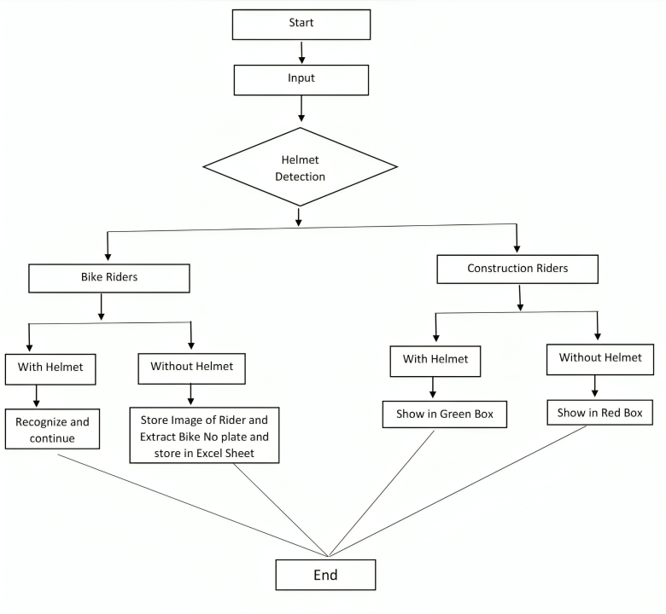
FLOW CHART
Start:
The process begins by initializing the system to analyze video frames or images.
Input Frames:
The system captures frames from the input video or camera feed for processing.
Check for Helmet:
Each frame is analyzed to determine if a person in the frame is wearing a helmet.
Decision Point:
Yes: If a person with a helmet is detected, the system reads the next frame to continue monitoring.
No: If no helmet is detected, it proceeds to check for the presence of a license plate.
Plate Detection:
If a license plate is detected, the system moves to the next step.
Decision Point:
No: If no plate is detected, the system loops back to process the next frame.
Yes: If a plate is detected, it proceeds to extract the details.
Extract Plate:
The detected license plate is processed for data extraction (e.g., characters, numbers, timestamp).
End:
The process completes for the current frame, and the system either continues with the next frame or stops based on the input feed.

Slide 14
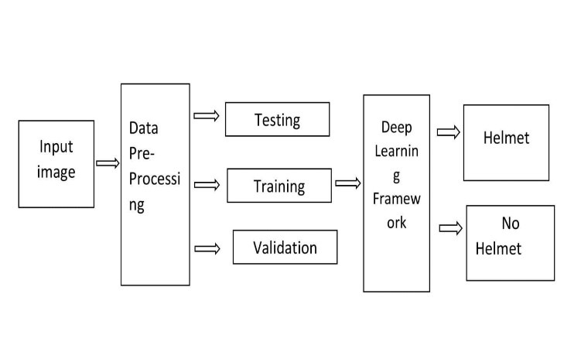
METHODOLOGY
Input Image: Captures raw images for processing.
Data Pre-Processing: Enhances image quality through resizing, normalization, and augmentation.
Dataset Split: Divides data into training, validation, and testing sets.
Deep Learning Framework: Uses CNN to classify images as "Helmet" or "No Helmet.“
Classification: Outputs whether a helmet is detected or not, ensuring safety compliance.

Slide 15
METHODOLOGY
1.Introduction to the Process The proposed methodology utilizes a deep learning-based approach for helmet detection and license plate extraction, emphasizing safety compliance in construction and road environments. Figure 1 illustrates the overall flow of the process.
2.Data Collection
Diverse Dataset: A comprehensive dataset is created by collecting images from various sources, including live camera footage and video recordings, covering diverse environments (construction sites, roads, etc.) under different conditions.
Annotations: Each image is annotated with bounding boxes and labels (helmet/no helmet), ensuring accurate model training and performance.
Diversity and Balance: The dataset balances helmeted and non-helmeted images, incorporating variations in helmet styles, colors, and environmental conditions.

Slide 16
METHODOLOGY
3.Data Preprocessing
Resizing: Images are resized to standard dimensions (e.g., 416x416 or 640x640 pixels) to ensure uniformity and efficient processing.
Data Augmentation: Techniques like rotation, scaling, and color adjustments are applied to improve the model’s robustness under varied scenarios.
Normalization: Pixel values are normalized to enhance the model's learning efficiency and stability.
Dataset Splitting: The dataset is divided into training (70%), validation (15%), and testing (15%) sets for effective model development and evaluation.

Slide 17
METHODOLOGY
4.Model Description
YOLOv8 Architecture: A modern object detection model known for speed and accuracy is used, with modifications like:
Slim-Neck Feature Fusion for efficient feature extraction.
Coordinate Attention Mechanism to enhance focus on helmet regions.
Small Target Detection Layer to handle small and partially obscured helmets.
Training Process: The model is trained using the annotated dataset, optimized with loss functions like IoU loss and focal loss, and evaluated using metrics like precision, recall, and mean Average Precision (mAP).
Implementation Tools: Frameworks like TensorFlow are used for building, training, and testing the model.

Slide 18
METHODOLOGY
5.Helmet Detection and License Plate Extraction
The system processes real-time video input to detect helmets and motorcycles.
If a helmet violation is detected, the license plate is extracted and stored along with violation evidence (images and details) for further review.
6.Significance The proposed methodology ensures high accuracy in detecting helmet usage and monitoring compliance in real-world scenarios, contributing to improved safety standards.

Slide 19
IMPLEMENTATION
Software Specifications:
YOLOv8 for real-time helmet detection
TensorFlow for model training
Python for backend processing
OpenCV for video handling and image capture
Hardware Requirements:
High-performance GPU (e.g., NVIDIA) for real-time video processing
CPU for data storage and monitoring

Slide 20
IMPLEMENTATION
Challenges Faced
1. Small Object Detection
Helmets are small and difficult to detect, especially in crowded or fast-moving environments.
2. Background Noise & Occlusions
Distinguishing helmets from background objects and handling cases where objects block the view.
3. Real-Time Processing
Processing video streams in real-time while maintaining accuracy was resource-intensive.

Slide 21
IMPLEMENTATION
Overcoming Challenges
1. Optimized YOLO Model
Trained on a diverse dataset to improve detection accuracy for small objects like helmets.
2. Preprocessing Techniques
Implemented background subtraction and noise reduction to handle occlusions.
3. Efficient Resource Management
Utilized GPUs and optimized the code to reduce processing time, achieving real-time performance.

Slide 22
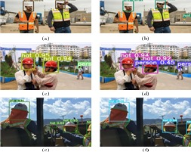
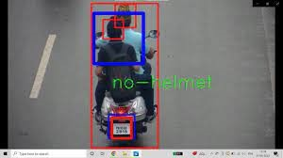
RESULTS & ANALYSIS
Helmet Detection and Image Storage
Successfully identified individuals in workplaces and stored their images in organized folders.
Enabled effective monitoring of personnel with or without helmets.
Identifying workers with safety helmets in various scenarios.
Detected bike riders without helmets and captured images of their license plates.

Slide 23

RESULTS & ANALYSIS
Bike Rider Detection and License Plate Storage
Detected bike riders without helmets and captured images of their license plates.
Organized license plate numbers into folders by date and time for easy retrieval.
Authorized personnel can access reports to analyze and improve safety measures.

Slide 24


RESULTS & ANALYSIS
Data Organization and Timestamping
Recorded details such as bike riders' images and license plate numbers in an Excel sheet.
Automatically labeled entries with date and time, ensuring accurate documentation.
Streamlined tracking of helmet violations, identifying repeat offenders, and supporting efficient auditing for improved safety measures.

Slide 25
CONCLUSION and FUTURE SCOPE
This project developed an efficient and reliable system for detecting helmet usage, incorporating data augmentation, a pre-trained model, and a user-friendly GUI. It automates monitoring, reducing manual effort and improving workplace safety.
FUTURE SCOPE
Expand dataset with diverse helmet images.
Optimize model for video frame processing.
Simplify the model using pruning techniques.
Enable real-time safety alerts.
Extend to monitor other safety equipment.

Slide 26
REFERENCES
G. Gallo, F. D. Rienzo, F. Garzelli, P. Ducange and C.Vallati, ”A Smart System for Personal Protective Equipment Detection in Industrial Environments Based on Deep Learning at the Edge,” in IEEE Access, vol. 10, pp. 110862-110878, 2022, do10.1109/ACCESS.2022.3215148.
Saibabu, Chaganti., Dungi, Jagath Kumari., Manthanwar, Dhananjay Chandrakant. (2022). Safety Management in Construction Industry: A Review. International Journal of New Innovations in Engineering and Technology, 20(2), 7-10. ISSN: 2319-6319(2).
Wang, Lili Zhang, Xinjie Yang, Hailu. (2023). Safety Helmet Wearing Detection Model Based on Improved YOLOM. IEEE Access. PP. 1-1. 10.1109/ACCESS.2023.3257183.
Han, Kun., Zeng, Xiangdong. (2022). Deep LearningBased Workers Safety Helmet Wearing Detection on Construction Sites Using Multi-Scale Features. IEEE Access, 10, 718- 729. doi:10.1109/ACCESS.2021.3138407
Jeong, Y. (2021). Self-Adaptive Motion PredictionBased Proactive Motion Planning for Autonomous Driving in Urban Environments. IEEE Access, 9, 105612-105625. doi:10.1109/ACCESS.2021.3100590(SelfAdaptiveMotionP r. . .).

Slide 27
REFERENCES
Dalal, N., Triggs, B. (2005). Histograms of Oriented Gradients for Human Detection. Proceedings of the IEEE Computer Society Conference on Computer Vision and Pattern Recognition, 1, 886–893.
Burges, C. J. C. (1998). A tutorial on support vector machines for pattern recognition. Data Mining and Knowledge Discovery, 2(2), 121–167.
Nath, N.D., Behzadan, A.H., Paal, S.G. (2020). Deep learning for site safety: Real-time detection of personal protective equipment. Automation in Construction, 112, 103085. DOI: 10.1016/j.autcon.2020.103085.
Talib, Moahaimen Al-Noori, Ahmed Suad, Jameelah. (2024). YOLOv8-CAB: Improved YOLOv8 for Real-time object detection. Karbala International Journal of Modern Science. 10. 10.33640/2405-609X.3339.
Slimani, I., Zaarane, A., Al Okaishi, W., Atouf, I., Hamdoun, A. (2020). An automated license plate detection and recognition system based on wavelet decomposition and CNN. Array, 8, 100040. https://doi.org/10.1016/j.array.2020.1000408203;

Slide 28
REFERENCES
Omar, Naaman Zeebaree, Subhi M.Sadeeq, Mohammed Zebari, Rizgar Shukur, Hanan Alkhayyat, Ahmed Haji, Lailan Kak, Shakir. (2023). License plate detection and recognition: A study of review. AIP Conference Proceedings. 050045. 10.1063/5.0170932.
Jibril, R. A., Utaminingrum, F., Budia, A. S. (2021). Helmet monitoring system using Hough Circle and HOG based on KNN. Lontar Komputer, 12(1), 13–23.https://doi.org/10.24843/LKJITI.2021.v12.i01.p028203;
Dalal, N., Triggs, B. (2005). Histograms of Oriented Gradients for Human Detection. Proceedings of the 2005 IEEE Computer Society Conference on Computer Vision and Pattern Recognition (CVPR’05), San Diego, CA, USA, 2005, pp. 886-893. doi: 10.1109/CVPR.2005.177
Lin, H., Deng, J. D., Albers, D., Siebert, F. W. (2020). Helmet Use Detection of Tracked Motorcycles Using CNNBased Multi-Task Learning. IEEE Access, 8, 162073-162084. https://doi.org/10.1109/ACCESS.2020.3021357
Sun, C. -Y., Hong, X. -J., Shi, S., Shen, Z. - Y., Zhang, H. -D., Zhou, L. -X. (2021). Cascade Faster R-CNN Detection for Vulnerable Plaques in OCT Images. IEEE Access, 9, 24697-24704. https://doi.org/10.1109/ACCESS.2021.3056448.

Slide 29
QUESTIONS and ANSWERS
Please ask questions if there are any doubts

Slide 30
ACKNOWLEGEMENTS
Thank you

